Slide 1
Chapter-5
User-Defined Functions

Slide 2

Outline
Function Introduction
Variable Passing (Pass-by-Value)
Optional Arguments
Sharing Data using Global Memory
Preserving Data between Calls to a Function
Function Functions
Sub-functions, Private Functions, Nested Functions

Slide 3
Functions Introduction
Syntax :
function [outArg1, outArg2, …] = funName(inarg1, inarg2, …)
% H1 Comment line
% Other Comment line
…
(Executable Code)
…
(return)
(end)

Slide 4
Functions Introduction
If we save file with .m extension then filename should be same as the function name.
Execution starts from the top of the function and ends when wither a return statement, an end statement or the end of the function is reached.
H1 Comments is a one line summery of the function.

Slide 5
Functions Introduction
Example :
function distance = dist2(x1, y1, x2, y2)
%DIST2 Calculate distance between 2 Points (H1 Comment)
% Function description, calling method, variable description, version information etc…
distance = sqrt( (x1-x2).^2 + (y1-y2).^2 );
end % Function distance
Calling a Function : a = dist2(x1, y1, x2, y2). If x1=0, y1=0, x2=3 and y2=4 then a=5.
help dist2 gives all the information of the function in command window which was return in the comment in that function.
lookfor distance produce the result information of the function in command window.

Slide 6
dist2.m
function distance = dist2 (x1, y1, x2, y2)
%DIST2 Calculate the distance between two points
% Function DIST2 calculates the distance between
% two points (x1,y1) and (x2,y2) in a Cartesian
% coordinate system.
%
% Calling sequence:
% distance = dist2(x1, y1, x2, y2)
% Define variables:
% x1 —— x-position of point 1
% y1 —— y-position of point 1
% x2 —— x-position of point 2
% y2 —— y-position of point 2
% distance —— Distance between points
% Record of revisions:
% Date Programmer Description of change
% ==== ========== =====================
% 02/01/07 S. J. Chapman Original code
% Calculate distance.
distance = sqrt((x2-x1).^2 + (y2-y1).^2);
end % function distance

Slide 7
test_dist2.m
% Purpose
% This program tests function dist2.
%
% Record of revisions:
% Date Programmer Description of change
% ==== ========== =====================
% 02/01/07 S. J. Chapman Original code
%
% Define variables:
% ax —— x-position of point a
% ay —— y-position of point a
% bx —— x-position of point b
% by —— y-position of point b
% result —— Distance between the points
% Get input data.
disp('Calculate the distance between two points:');
ax = input('Enter x value of point a: ');
ay = input('Enter y value of point a: ');
bx = input('Enter x value of point b: ');
by = input('Enter y value of point b: ');
% Evaluate function
result = dist2 (ax, ay, bx, by);
% Write out result.
fprintf('The distance between points a and b is %f\n',result);

Slide 8

Command Window
>> test_dist2
Calculate the distance between two points:
Enter x value of point a: 0
Enter y value of point a: 0
Enter x value of point b: 3
Enter y value of point b: 4
The distance between points a and b is 5.000000
>> help dist2
dist2 Calculate the distance between two points
Function dist2 calculates the distance between
two points (x1,y1) and (x2,y2) in a Cartesian
coordinate system.
Calling sequence:
distance = dist2(x1, y1, x2, y2)
dist2.m and test_dist2.m, both files are in same directory.

Slide 9

Variable Passing
(Pass-by-Value)
Program Communicate with their functions using a pass-by-value scheme.
When function call occur, MATLAB makes a copy of an actual arguments and passes them to the function.
Workspace
Name Value
ax 0
ay 0
bx 3
by 4
Before the function call
Workspace
Name Value
distance 5
x1 0
y1 0
x2 3
y2 4
During the function call
Workspace
Name Value
ax 0
ay 0
bx 3
by 4
result 5
After the function call

Slide 10
Optional Arguments
nargin - returns the number of actual input arguments
nargout - returns the number of actual output arguments
nargchk(min_args, max_args, actual_num_args) - return a standard error message if a function is called with too few or too many arguments.
error(‘msg’) - display error message and abort the function to producing the error.
warning(‘msg’) - display warning message and continue function execution.
inputname(argn0) - returns the actual name of the variable that corresponds to a particular argument number.
In new version of MATLAB, instead of nargchk() function narginchk(min_args, max_args) and nargoutchk(min_args, max_args) functions are used.

Slide 11
area.m
function [value, type] = area(length, width)
%AREA Calculate the area and gives type of the object
% Function AREA calculates the area of
% Rectangle or Square and also return type of the object
% Calling sequence:
% [value, type] = area(length, width)
% Define variables:
% length —— length of square/rectangle
% width —— width of square/rectangle
% area —— area of square/rectangle
% type —— type of object
msg = nargchk(1,2,nargin);
error(msg);
if nargin < 2
width = length;
end
if length == 0 && width == 0
warning('Length and Width both are 0 : Area is meaningless');
end
value = length * width;
if nargout == 2
type = 'Rectangle';
if length == width
type = 'Square';
end
end
end

Slide 12
Command Window
>> val = area(2,3,4)
Error using area
Too many input arguments.
>> val = area(0)
Warning: Length and Width both are 0 : Area is meaningless
> In area (line 10)
val =
0
>> val = area(5,6)
val =
30
>> [val, type] = area(5)
val =
25
type =
'Square'
>> [val, type] = area(5,10)
val =
50
type =
'Rectangle'
>> val = area(10,10)
val =
100

Slide 13


Sharing Data using Global Memory
Syntax :
global var1 var2 var3 …
Global memory provides a way to share data between functions.
Declare global variable in all capital letters to make them easy to distinguish from local variable. But this is not actually a requirement.
reverse.m
global ar;
ar = [10, 20, 30, 40];
reverseVector()
ar
function reverseVector()
global ar;
ar = ar(end:-1:1);
end
Command Window
>> reverse
ar =
40 30 20 10

Slide 14
Preserving Data between Calls to a function
Syntax :
persistent var1 var2 var3 …
persistent variable is used to preserve the values of the local variables within a function between calls to the function.
Declare global variable in all capital letters to make them easy to distinguish from local variable. But this is not actually a requirement.

Slide 15

persistent_count.m
function persistent_count()
persistent count
if isempty(count)
count = 0
else
count = count + 1
end
end
Command Window
>> persistent_count
count =
0
>> persistent_count
count =
1
>> persistent_count
count =
2
>> persistent_count
count =
3
>> persistent_count
count =
4

Slide 16
Function Functions
Function, whose input arguments include the name of other functions.
fminbnd - minimize function of one variable
fzero - returns a zero of a function
quad - numerically integrate a function
ezplot - easy to use functional plotter
fplot - plot a function by name
eval - evaluates passed string as a function
feval - evaluates passed string as a function with specific point

Slide 17
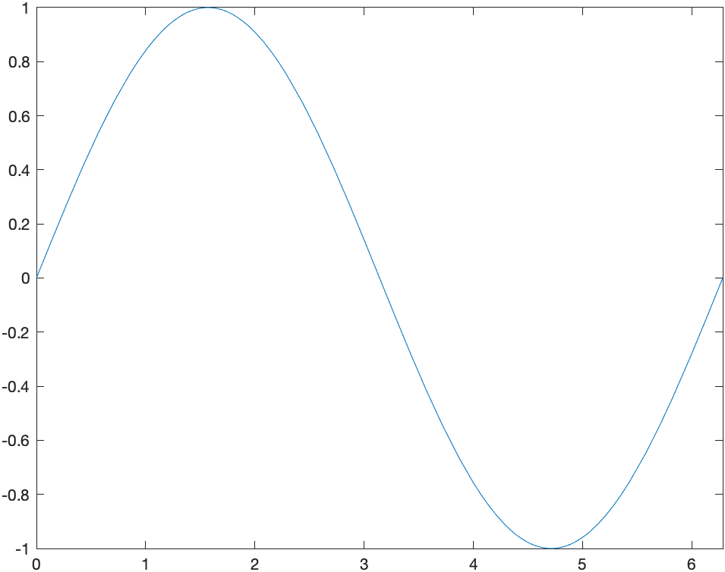



Command Window
>> X = fminbnd(@sin,0,2*pi) % at X=4.7124, sin function gives minimum value
X =
4.7124
>> X = fminbnd(@cos,0,2*pi) % at X=3.1416, sin function gives minimum value
X =
3.1416
>> X = fminbnd(@tan,0,2*pi) % at X=1.5708, sin function gives minimum value
X =
1.5708
>> Y = fzero('sin',[0 pi]) % at X=0, sin function value is 0
Y =
0
>> Y = fzero('cos',[0 pi]) % at X=1.5708, cos function value is 0
Y =
1.5708
>> fplot(@sin,[0 2*pi])
>> Z = eval('tan(pi/4)')
Z =
1
>> Z = feval('tan',pi/4)
Z =
1

Slide 18
Sub-functions
Syntax :
function [outArg1, outArg2, …] = funName(inarg1, inarg2, …)
(Executable Code)
% Call of subFunction
(return)
(end)
function [oa1, oa2, …] = subFunction(ia1, ia2, …)
(Executable Code)
(return)
(end)

Slide 19

statistics.m
function [avg, med] = statistics(vector)
avg = average(vector);
med = median(vector);
end
function avg = average(vector) % Sub Function
avg = sum(vector)/length(vector);
end
function med = median(vector) % Sub Function
vector = sort(vector);
if mod(length(vector),2) == 1
med = vector( (length(vector) + 1) /2 );
else
med = ( vector( length(vector)/2 ) + vector( ( length(vector)/2 ) + 1 ) ) / 2;
end
end
Command Window
>> [avg median] = statistics([4 2 5 2 3])
avg =
3.2
median =
3
>> [avg median] = statistics([4 2 5 2 3 6])
avg =
3.6667
median =
3.5

Slide 20
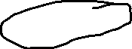
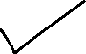
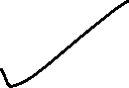
Private functions
Private function is only accessible from inside the file which was contain that private function.
Outside of the file we can not access those function.
How to make Private Functions :
Make a folder which name is private in the main directory.
Save private functions into that folder.
Set path to the main directory and then call the function so it will work as a private function.
Private function is accessible upto main directory.
Suppose in myfun.m file we have three functions myfun, mean and median. From that mean and median are the private functions. So we did not access them out side of the myfun.m file but myfun is accessible out side of the file.

Slide 21

Private functions
📁 Documents
Save Private Functions into Private folder.
Change Folder path to the Main Directory.
Run main code
You can see that Private Function is only accessible in Main Directory.
Outside this Directory Private Function are not accessible.
📁 Downloads
📁 Movies
📂 Nirma University
📁 Machine Learning
📂 MATLAB
📂 Main Directory
📉 mainCode.m
📉 subCode.m
📂 Private
📉 privateFunction1.m
📉 privateFunction2.m
📁 Computer Networks
📁 Photos

Slide 22
Nested functions
Syntax :
function [outArg1, outArg2, …] = funName(inarg1, inarg2, …)
% Call of nestedFunction
(Executable Code)
(return)
function [oa1, oa2, …] = nestedFunction(ia1, ia2, …)
(Executable Code)
…
(return)
(end)
(end)

Slide 23
statistics.m
function [avg, med] = statistics(vector)
avg = average(vector);
med = median(vector);
function a = average(vector) % Nested Function
a = sum(vector)/length(vector);
end
function m = median(vector) % Nested Function
vector = sort(vector);
if mod(length(vector),2) == 1
m = vector( (length(vector) + 1) /2 );
else
m = ( vector( length(vector)/2 ) + vector( ( length(vector)/2 ) + 1 ) ) / 2;
end
end
end
Command Window
>> [avg median] = statistics([4 2 5 2 3])
avg =
3.2
median =
3
>> [avg median] = statistics([4 2 5 2 3 6])
avg =
3.6667
median =
3.5

Slide 24
Thank You

